Slide 1

Chef For Everyone (CFE)
Group 4:
Nguyễn Thanh Tân
Nguyễn Phan Khôi Nguyên
Nguyễn Tấn Sang (K14)
Nguyễn Tấn Sang (K13)

Slide 2
Why CFE
Overview
- This app is use for every person, family or company with a lot of benefits, they can choose chefs they like the service they want to be served at home or somewhere at the company. And they don’t need to go outside or go to the restaurant to get contact with master chef. This app can make your life become convenient.
- With this app chefs can get a second job when they have free time and for all students with drink and food is their major subjects. They can get job, experience and money for pay fee.

Slide 3
Major Features
Book chef from the CFE menu to be picked up or home service.
Create, view, modify, and cancel booking for standing or recurring chef service orders.
Create, view, modify, delete, and archive chef’s menus.
View ingredient lists and nutritional information for chef’s menu items.
Provide system access through corporate intranet, smartphone, tablet, and outside Internet access by authorized employees.

Slide 4
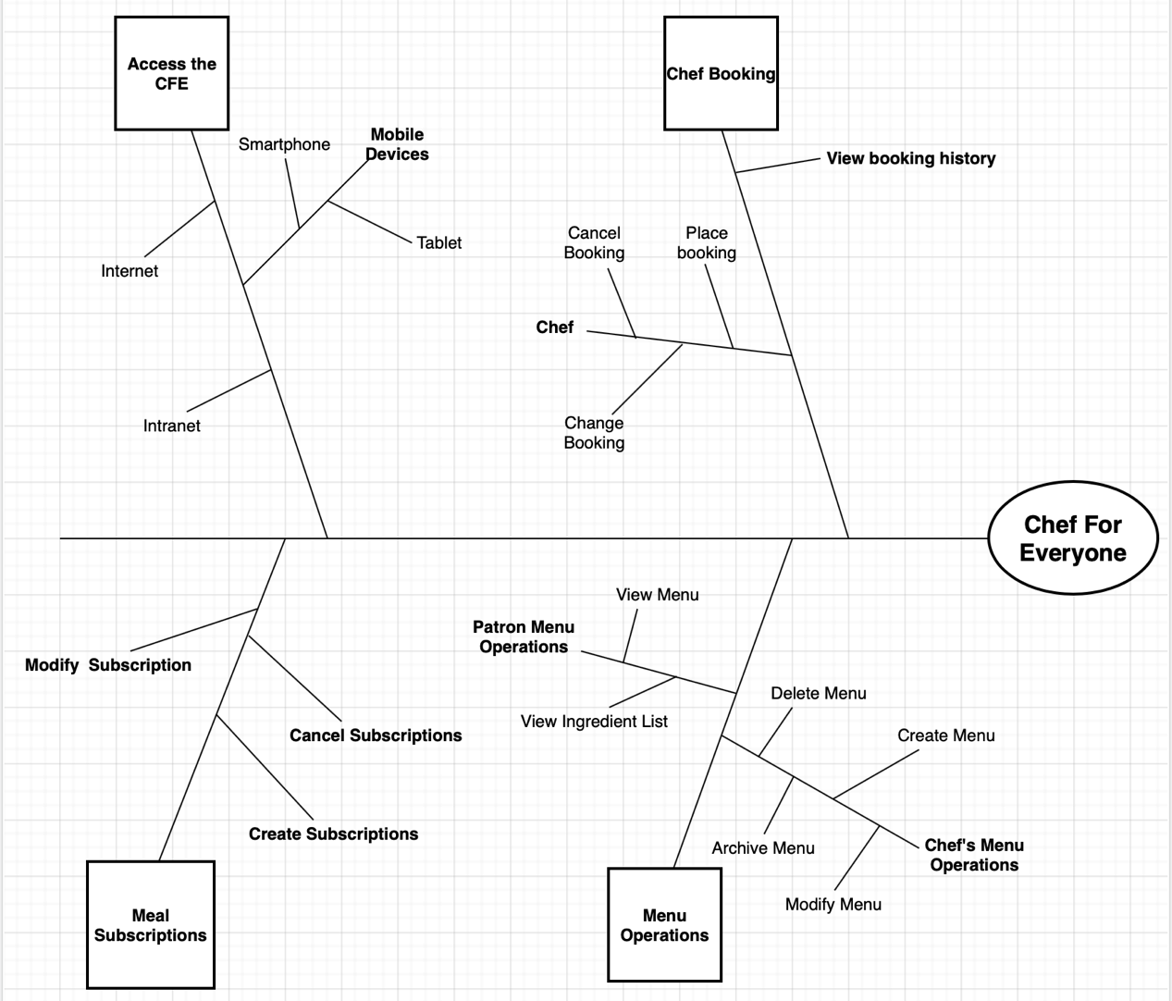
Partial feature tree for the Chef For Everyone.

Slide 5
Use cases

Slide 6

Thank you for listening !

